Slide 1
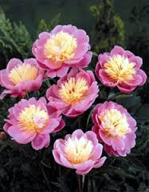
Welcome

Slide 2
Introduction
Tahmina
Assistant Teacher,
Saildia Dakhil Madrasah
Kaligonj,Gazipur.

Slide 3
Class:6
Sub:English 1st paper
Time:50M

Slide 4
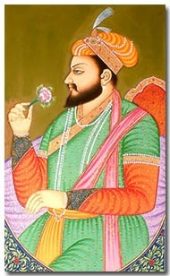
Emperor Shah Jahan

Slide 5
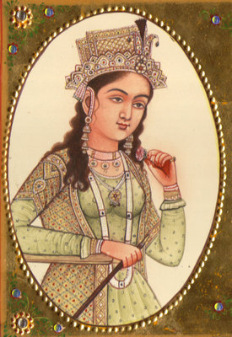
Empress Mumtaz

Slide 6
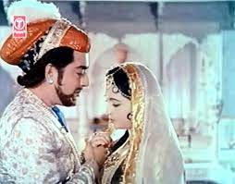
Shajahan and Mumtaj

Slide 7
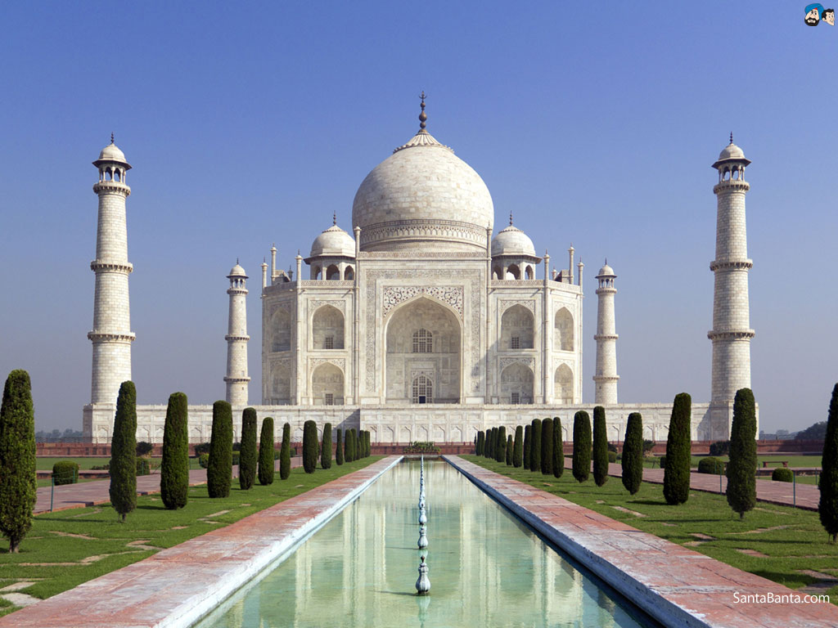
Tajmahal

Slide 8
Learning Outcomes
By the end of the lesson the student will be able to
Say the meaning of the new words.
Pronounce the words.
Listen and understand the story.

Slide 9

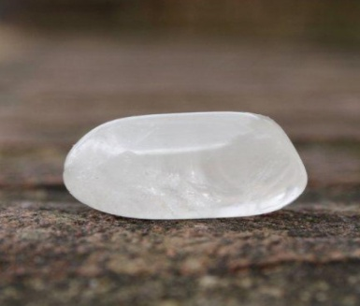
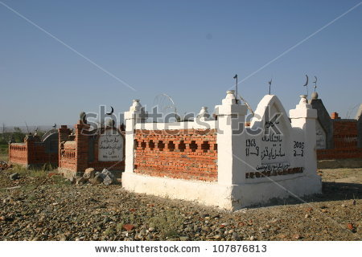
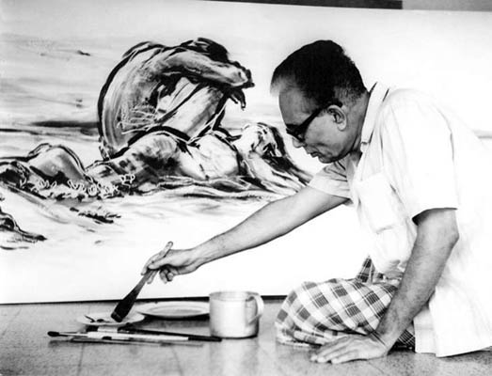
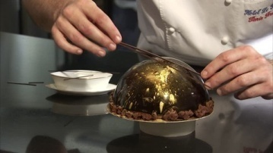
Vocabulary
A grave
Mrble
Fine Limestone
Tomb
Architecture
The art
Craftsman
A skilled workman

Slide 10
Group Work
Answer to the Following question
1.Who did build the Tajmahal?
2.Where Mumtaj is sleeping forever?

Slide 11
Evaluation
1.Where is Tajmahal?
2.Where is Agra?
3.Who is Mumtaj?

Slide 12

Home Work
Write a paragraph about Tajmahal.

Slide 13

Thanks Everybody

